Slide 1
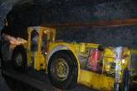
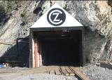
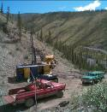
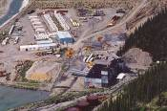
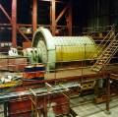
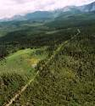
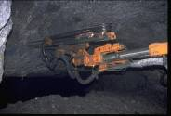
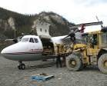
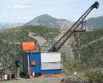
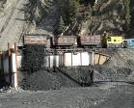
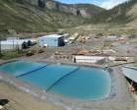
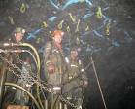
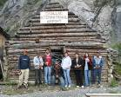
PRAIRIE CREEK MINE:
ALL SEASON ROAD
ENVIRONMENTAL ASSESSMENT SCOPING
June, 2014

Slide 2
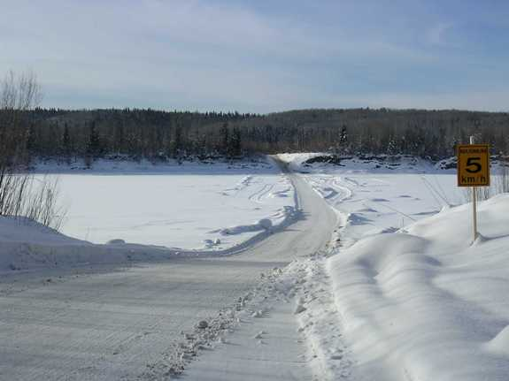
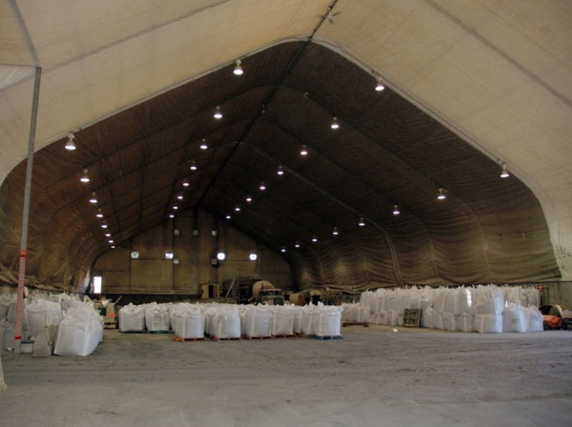
Mine Access Road and Transfer Facilities
Ice Bridge
Transfer Facilities

Slide 3
Winter Road Operation Strategy
Open western part of road to Tetcela Transfer Facility (TTF) in early winter
Start haul of concentrates to TTF
Open eastern part of road to Liard Hwy by January 15
Complete concentrate haul by March 31

Slide 4
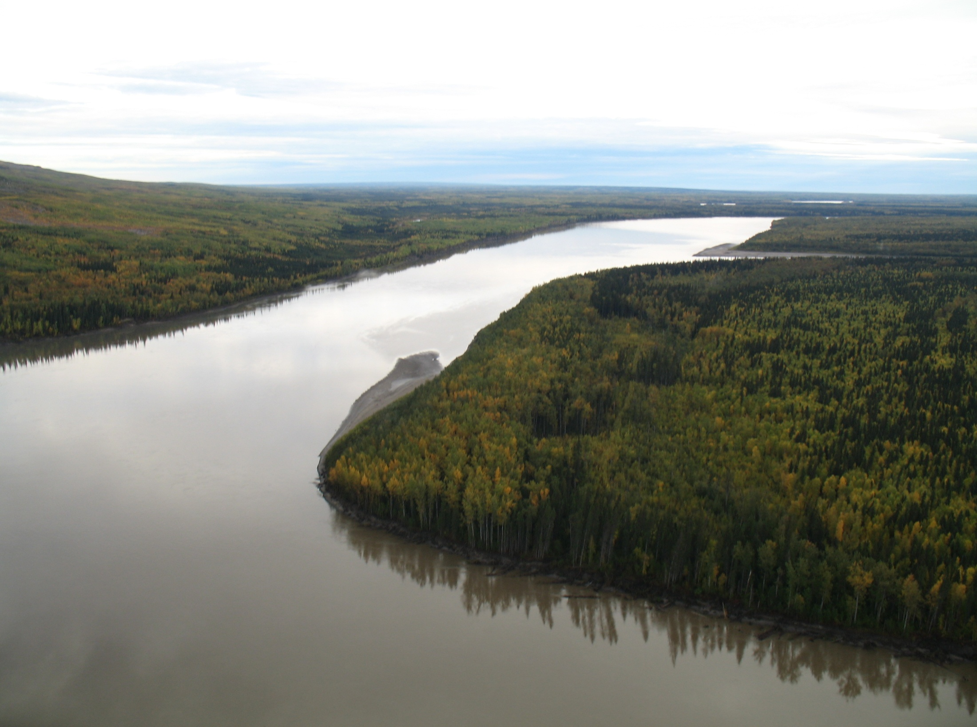
The Nahanni Route Re-alignment and Liard Crossing: Location of Ice Bridge during winter operations
Facing East
Lindberg’s Landing
New Alignment
Tache
Nahanni Logging Road
LIARD RIVER

Slide 5
Expected Liard Facility Transfer Traffic
From |  | Trips | Period
 |  | per Day | From |  | To
Mine |  | 58 | January 15 |  | March 6
Mine |  | 37 | March 6 |  | April 15
Fort Nelson |  | 14 | January 15 |  | October 15
Dates subject to weather

Slide 6
Winter Road Operation Issues
Risk of early winter opening not possible
Risk of accidents in busy winter period, especially in the mountains
Mine revenue from concentrates stranded until delivered to market

Slide 7
All Season Road Opportunities
An all season road bed already exists between the Mine and Cat Camp (Km 40), and was permitted for all season use previously
Very little soft ground between the Mine and the TTF
An all season road would be a regional stimulus

Slide 8
All Season Road Application
Phase 1 – CZN only
– All season road from the Mine to TTF, taking advantage of existing bed and good ground
– Expansion of the TTF to store more concentrates and allow for a refuelling station
- A 2nd airstrip connected to the road to improve access to the Mine
Phase 2 – Collaboration?
– All season road from the TTF to the Liard Highway, but much more soft ground

Slide 9
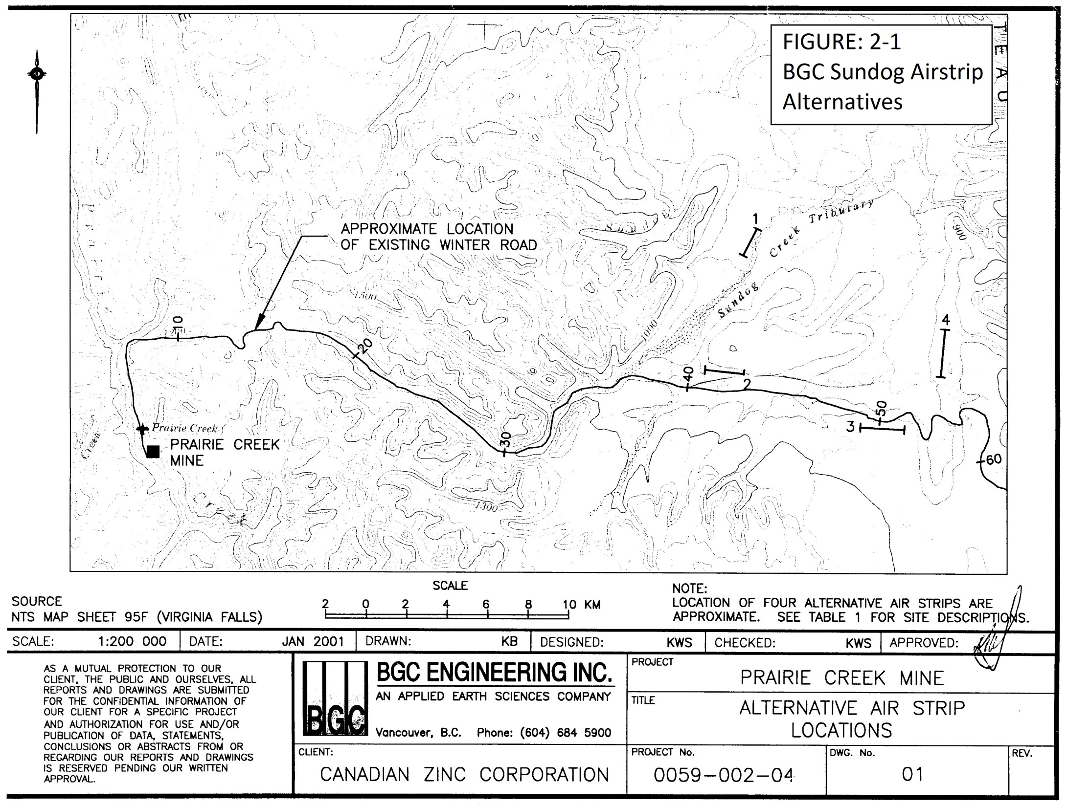
Airstrip Location

Slide 10
All Season Road Construction
Use of winter road alignment, with possible minor alterations
Single lane with turn-outs
Road sub-bed of fill with gravel surfacing
Appropriate stream crossing and runoff management structures
Barge ramps and landings on the Liard River

Slide 11
All Season Road Traffic
Estimated 16 truck trips per day from the Mine, likely in convoys, taking concentrates out and bringing supplies in on backhaul
Limited number of special deliveries e.g. explosives
No change in Liard Highway traffic

Slide 12
Potential Environmental Issues
Phase 1
Creek crossings
Wildlife disturbance
Risk of spills, especially on karst

Slide 13
Potential Environmental Issues
Phase 2
Creek crossings
Wildlife disturbance
Hunting pressure on wildlife from increased access
Increased tourism
Summer Mine traffic

Slide 14
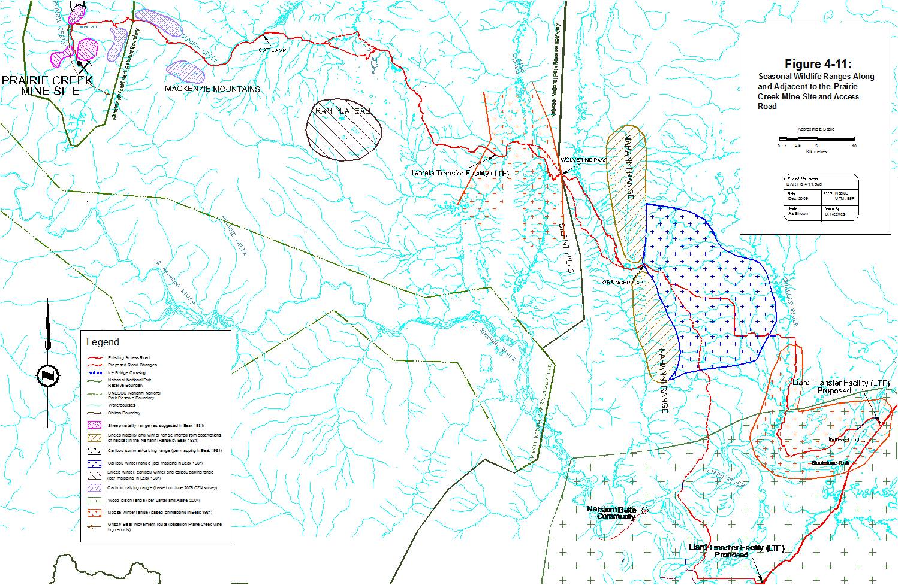
Wildlife

Slide 15
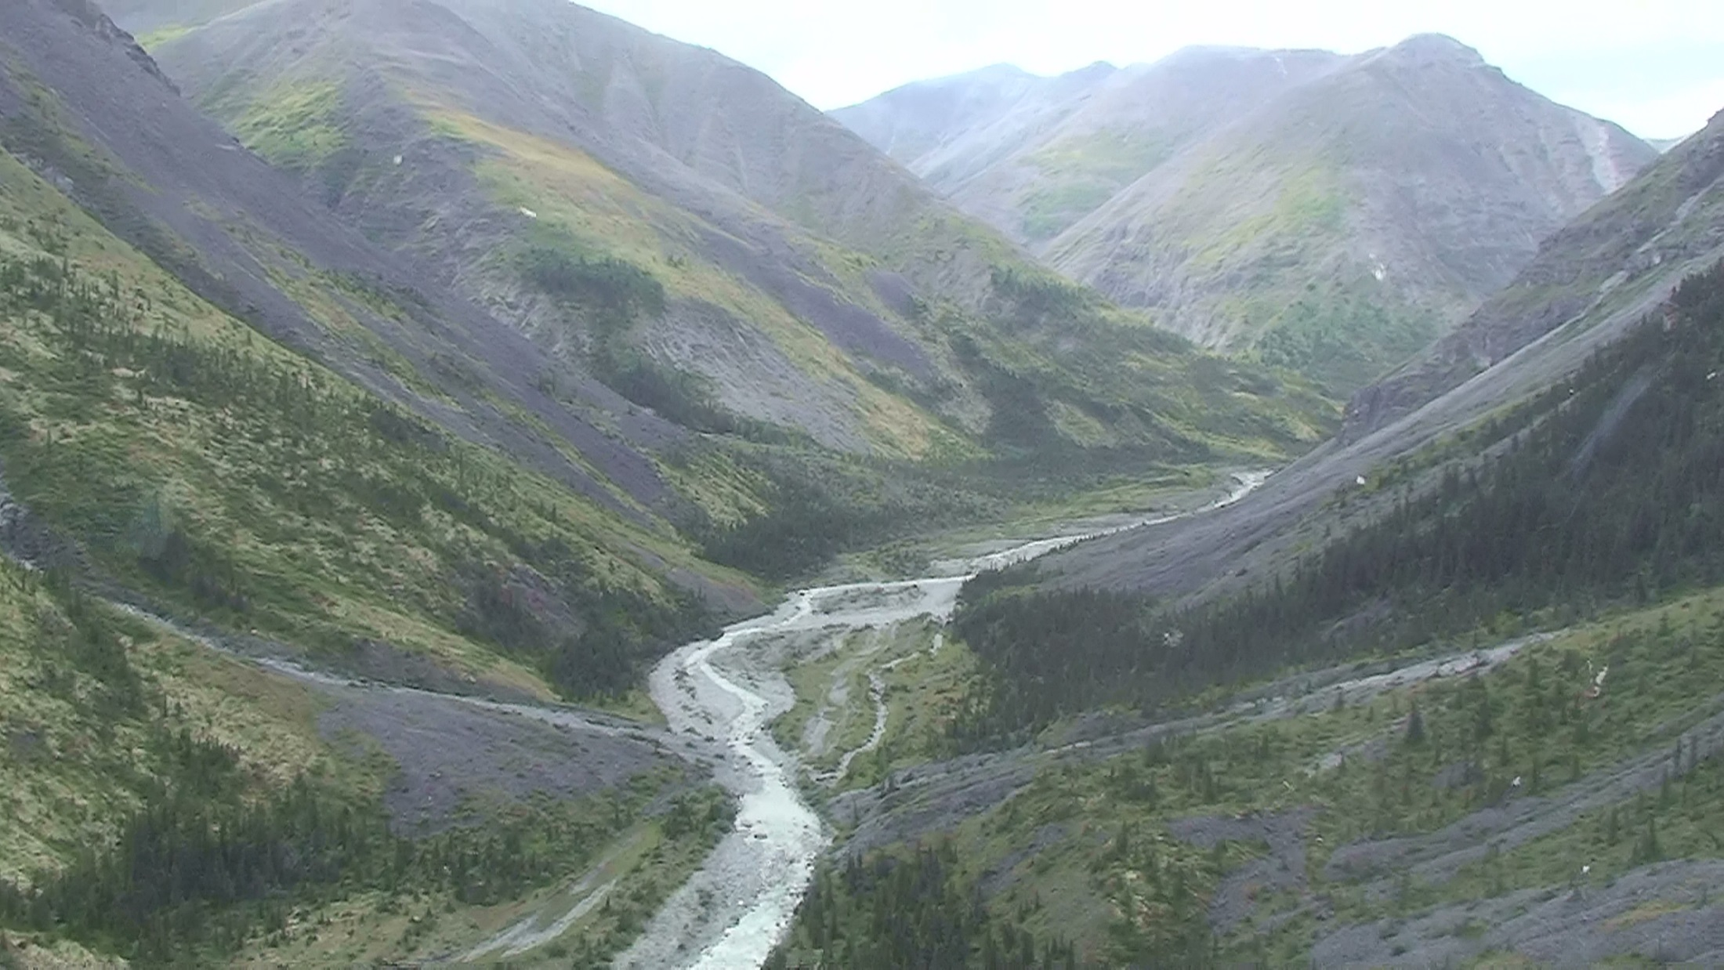
Fish

Slide 16
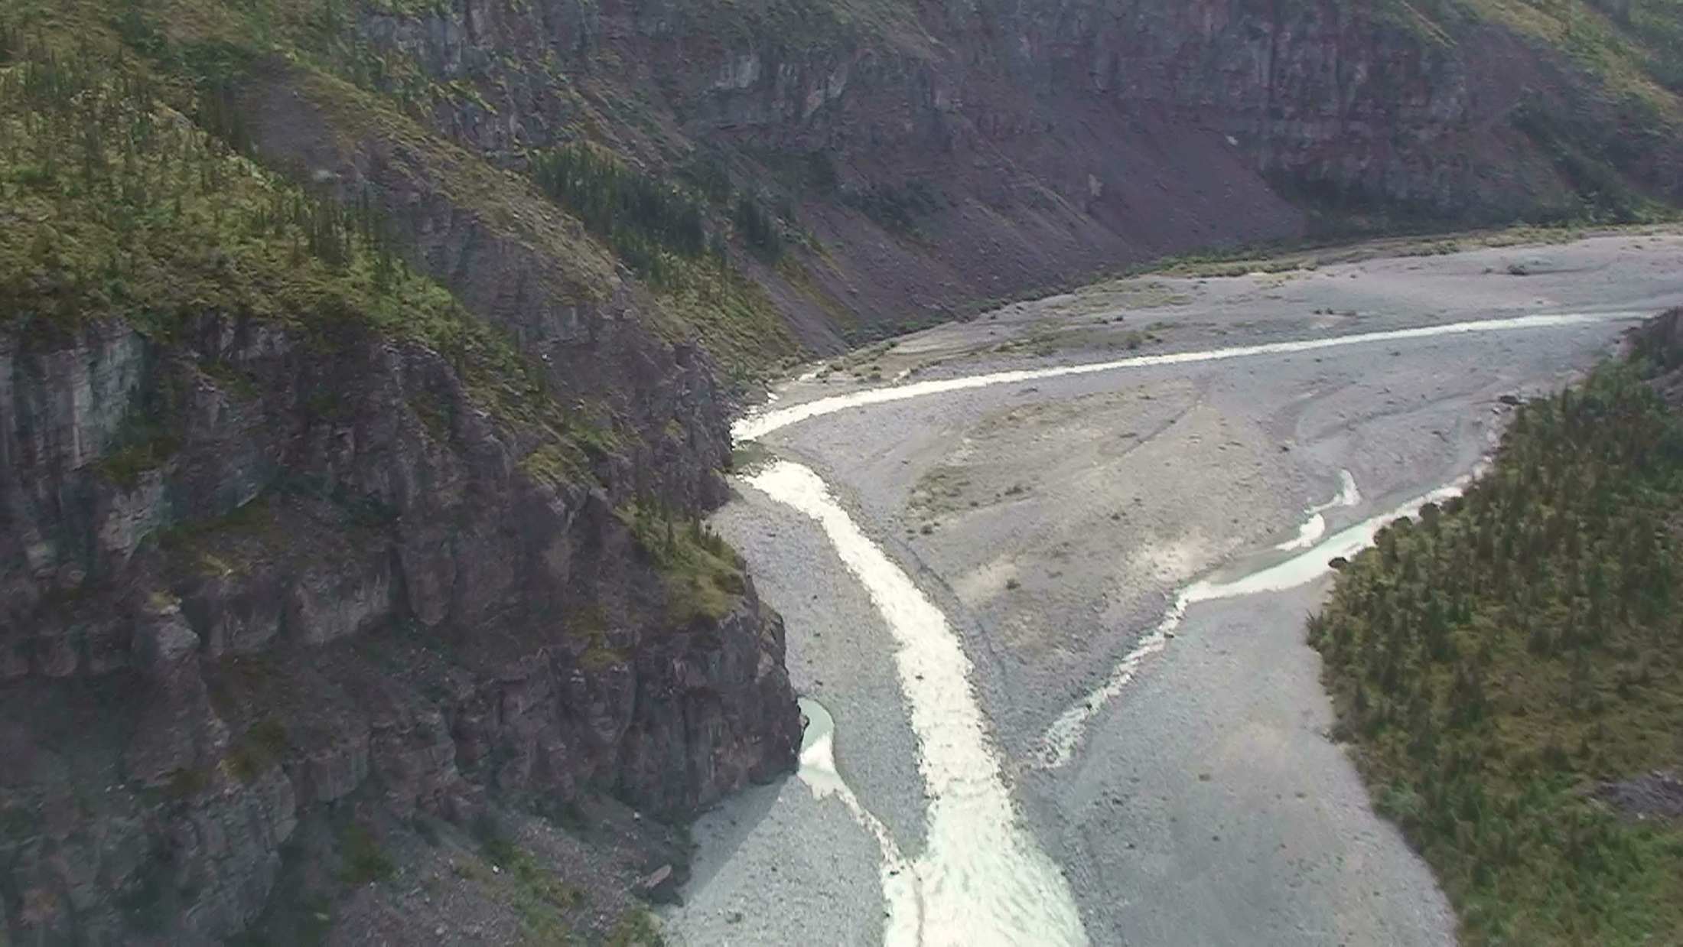
Fish

Slide 17
All Season Road Application
Thank you
Questions?

